Slide 1

Superstore Sales Dashboard Comprehensive Analysis of Sales Data
NagendrA V KINI

Slide 2
iNTRODUCTION
OBJECTIVES OF THE DASHBOARD :-
Dynamic visualization of sales and YOY growth KPIs.
Insight breakdown by category, segment, and top-selling products.
Detailed monthly analysis for each year.
Brief overview of the Superstore Sales Dashboard project.
To showcase dynamic visualization of sales and YOY growth KPIs.

Slide 3
Key Features of the Dashboard
Sales and Profit KPIs at a glance.
Drill-down capability for detailed category analysis.
Insights on top-selling products.
Segment-wise performance breakdown.
Monthly insights for each year.

Slide 4
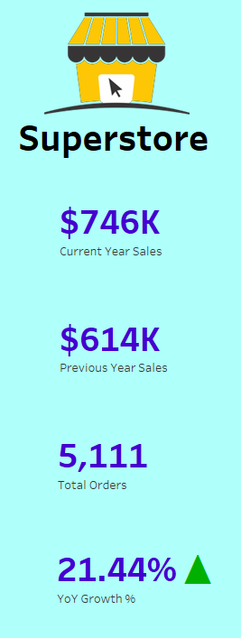
Insights :-
SALES AND PROFIT KPI
Sales and Profit KPIs
Visual representation of overall sales and profit.
Key metrics highlighted for quick insights.

Slide 5
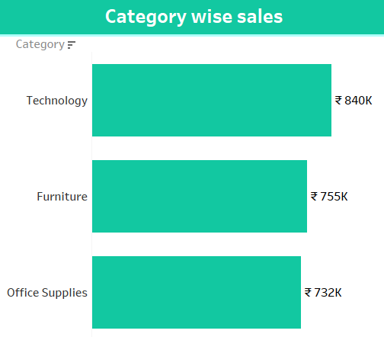
Insights :-
CATEGORY ANALYSIS
Drill Down into Categories
Detailed breakdown of sales and profit by category.
Visuals showing category-wise performance.

Slide 6
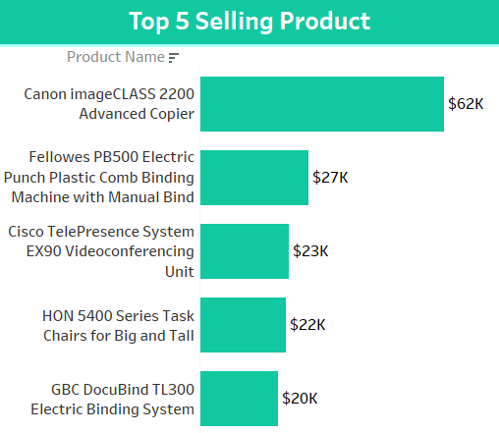
Insights :-
TOP - SELLING PRODUCTS
Top - Selling Products
List and visuals of the top-selling products.
Insights on why these products are top sellers.

Slide 7
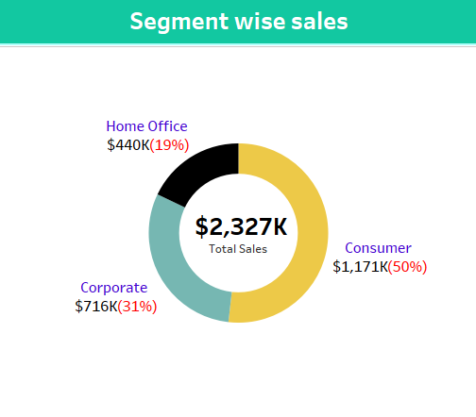
Insights :-
SEGMENT - WISE PERFORMANCE
Segment - Wise Performance Breakdown
Analysis of sales and profit by customer segment.
Visual representation of segment performance.

Slide 8
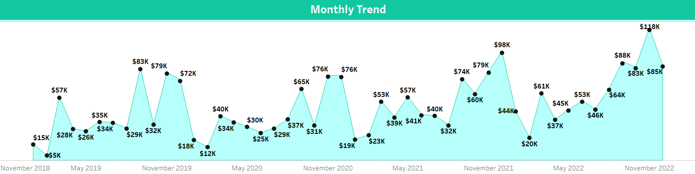
Insights :-
MONTHLY INSIGHTS
Monthly Insights for Each Year
Monthly sales trends and patterns.
Year - over - year comparison to highlight growth trends.

Slide 9
Conclusion
CONCLUSION
Year-on-year sales growth.
Technological field showing the highest sales.
Importance of converting raw data into meaningful information.
Effectiveness of Tableau in creating insightful dashboards.
SUMMARY OF KEY FINDINGS :-

Slide 10
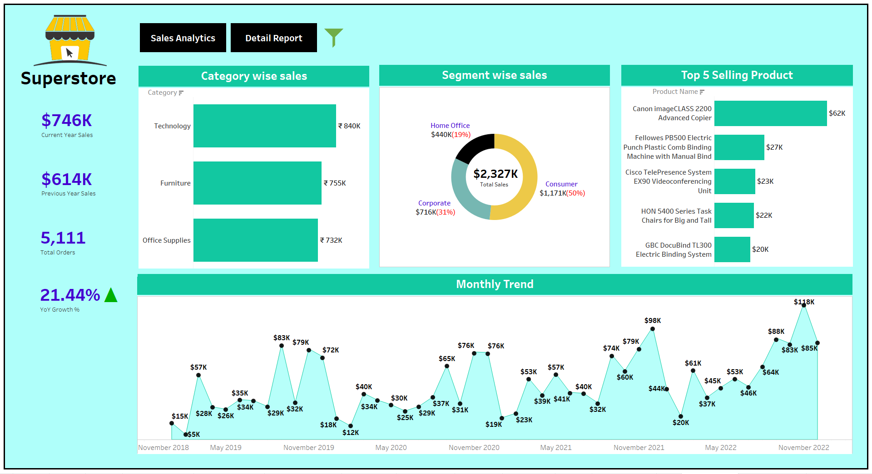
DASHBOARD

Slide 11
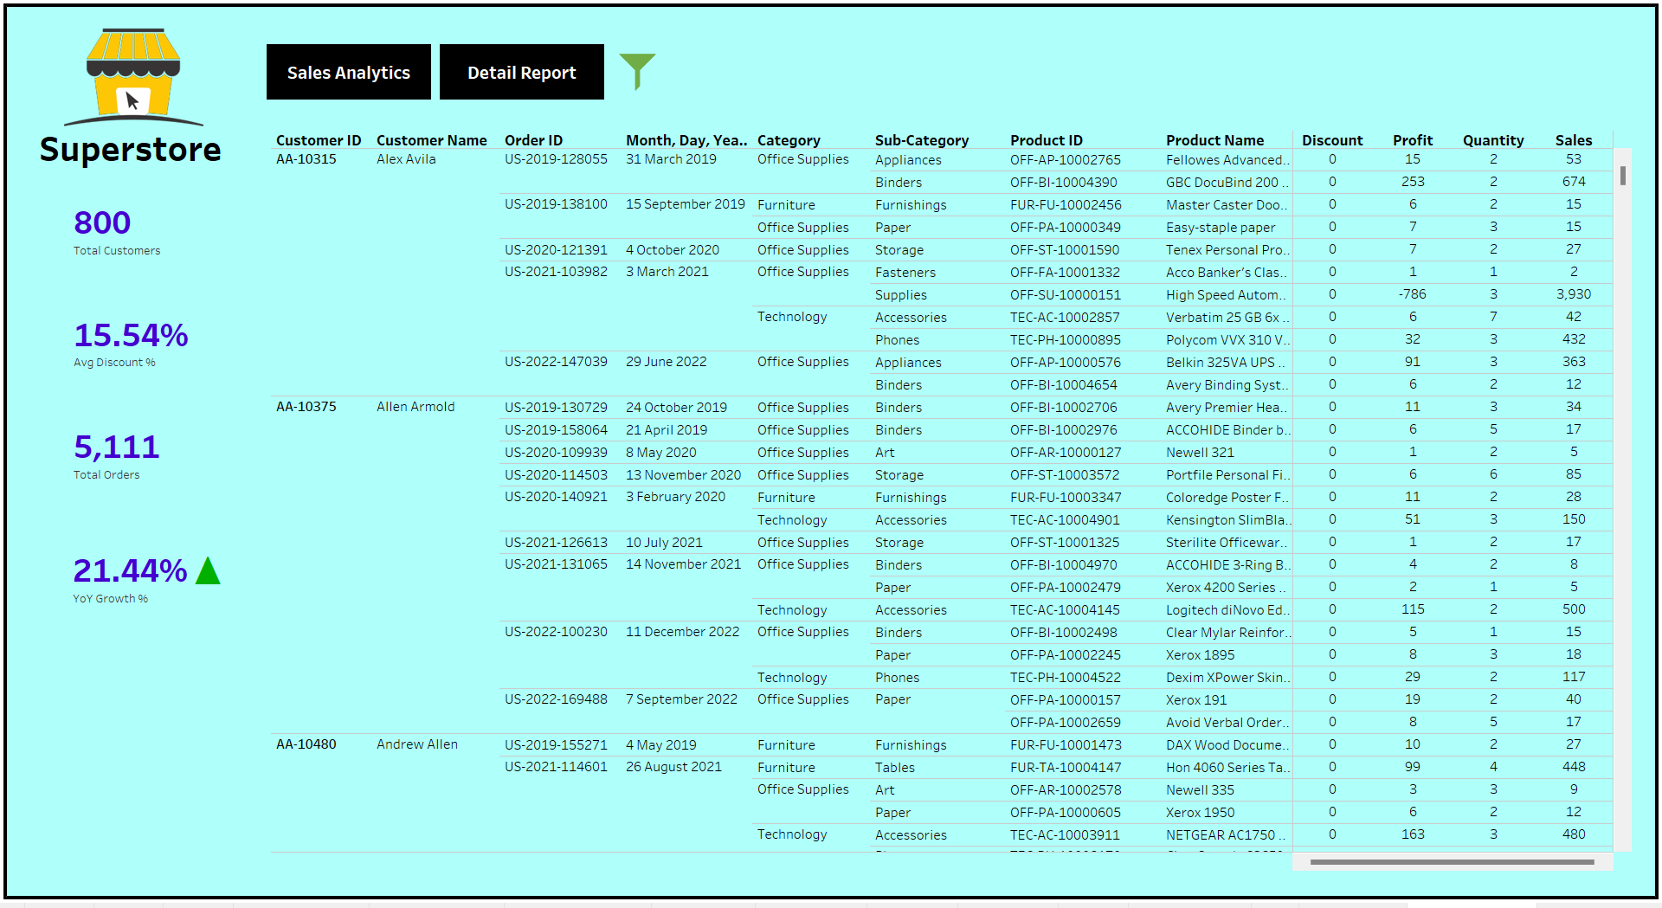
DASHBOARD

Slide 12
THANK YOU

